Slide 1
John Searle’s Ontology of Social Reality
Its Glory and Its Misery
Barry Smith

Slide 2
Speech Act Theory

Slide 3
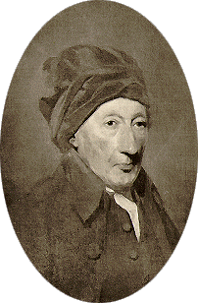
Speech Act Theory
  Thomas Reid:

Slide 4
Speech Act Theory
  Thomas Reid:
    the principles of the art of language are to be found in a just analysis of the various species of sentences.
    Aristotle and the logicians have analysed one species – to wit, the proposition.
    To enumerate and analyse the other species must, I think, be the foundation of a just theory of language.

Slide 5
Reid’s theory of
‘social operations’
    ‘social acts’ vs. ‘solitary acts’
    A social act … must be directed to some other person –
    it constitutes a miniature ‘civil society’

Slide 6
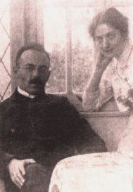
Adolf Reinach
(with saint)

Slide 7
Adolf Reinach
    Reinach’s theory of social acts
    1913: The A Priori Foundations of the Civil Law
    a response to
    Husserl’s internalistic theory of meaning

Slide 8
Adolf Reinach
    Reinach’s ontology of the promise
    part of a wider ontology of legal phenomena such as contract and legislation,
    a ‘contribution to the general ontology of social interaction’

Slide 9
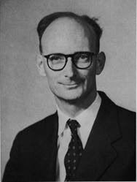
Austin

Slide 10
Austin
  Break from Aristotle/Frege in “Other Minds” 1946

Slide 11
Austin
  Saying “I know that S is P”
  is not saying “I have performed a specially striking feat of cognition ...”.
  Rather,
  When I say “I know” I give others my word: I give others my authority for saying that “S is P”.

Slide 12
Austin
    Similarly:
    ‘promising is not something superior, in the same scale as hoping and intending’.
    Rather, when I say ‘I promise’
    I have not merely announced my intention, but, by using this formula (performing this ritual), I have bound myself to others, and staked my reputation, in a new way.

Slide 13
“A Plea for Excuses”
  recommends three ‘source-books’ for the study of (speech) actions: the dictionary, the law, and psychology.

Slide 14
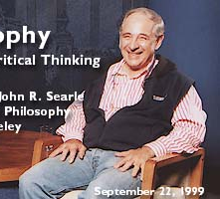
Searle

Slide 15
Searle’s Speech Acts (1969)
    Regulative vs. Constitutive Rules
    The former merely regulate antecedently existing forms of behaviour, as rules of polite table behaviour regulate eating
    The latter create new forms of behaviour, as the rules of chess create the very possibility of our engaging in the type of activity we call playing chess.

Slide 16
Constitutive rules
  have the basic form:
    X counts as Y in context C
    Examples:
    signaling to turn left
    bidding in an auction house

Slide 17
Constitutive rules
    An utterance of the form ‘I promise to mow the lawn’ counts as putting oneself under a corresponding obligation.
    The Y term in a constitutive rule characteristically marks something that has consequences in the form of rewards, penalties, obligations to act.

Slide 18
Constitutive rules
  form systems:
    acting in accordance with all, or a sufficiently large subset of, these and those rules by individuals of these and those sorts
    counts as
    playing basketball.

Slide 19
Searle’s central hypothesis
  speech acts are acts characteristically performed by uttering expressions in accordance with certain constitutive rules
  (compare, again, playing chess)
  an institutional fact = a fact whose existence presupposes the existence of certain systems of constitutive rules called ‘institutions’.

Slide 20
Brute vs. Institutional Facts

Slide 21
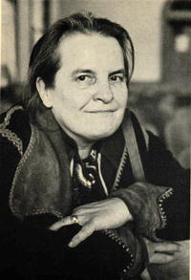
Miss Anscombe

Slide 22
“On Brute Facts”
    What makes behaving in such and such a way a transaction?
      A set of events is the ordering and supplying of potatoes, and something is a bill, only in the context of our institutions. (Anscombe 1958)

Slide 23
Anscombe “On Brute Facts”
    As compared with supplying me with a quarter of potatoes we might call carting a quarter of potatoes to my house and leaving them there a “brute fact”.
    But as compared with the fact that I owe the grocer such-and-such a sum of money, that he supplied me with a quarter of potatoes is itself a brute fact. (Anscombe 1958, p. 24)

Slide 24
Searle: there is only one level of brute facts
    – constituted by the facts of natural science
    From out of this there arises a hierarchy of institutional facts at successively higher levels.

Slide 25
Brute facts
    are independent of all human institutions, including the institution of language.

Slide 26
Searle:
When you perform a speech act then you create certain institutional facts
(what Reid referred to as a miniature ‘civil society’).

Slide 27
Institutional facts
    exist because we are here to treat the world and each other in certain, very special (cognitive) ways
    Institutions are systems of constitutive rules.
    Examples of institutions:
    money
    property
    marriage
    government

Slide 28
Problem
    how can a mere utterance give rise to a mutually correlated obligation and claim?
    Searle will explain how these consequences arise by means of his theory of constitutive rules.

Slide 29
Every institutional fact
  is underlain by a (system of) rule(s) of the form “X counts as Y in context C”. (Searle 1969)

Slide 30
Such constitutive rules
    affect our behavior in the following way:
    where such rules obtain we can perform certain special types of activities
    (analogous, again, to playing chess)
    in virtue of this our behavior can be interpreted by ourselves and by others in terms of certain very special types of institutional concepts.

Slide 31
Promises
    are utterances which count as falling under the institutional concept act of promise,
    The latter is itself logically tied to further concepts such as claim and obligation.

Slide 32

Searle’s Ontology of Social Reality

Slide 33
Social Reality
  I go into a café in Paris and sit in a chair at a table.
  The waiter comes and I utter a fragment of a French sentence.
  I say, ‘un demi, Munich, pression, s’il vous plaît.’
  The waiter brings the beer and I drink it.
  I leave some money on the table and leave.
  ^{THIS SCENE HAS A ‘HUGE} ^{INVISIBLE ONTOLOGY’}

Slide 34
Social Reality
    the waiter did not actually own the beer he gave me, but he is employed by the restaurant which owned it.
    The restaurant is required to post a list of the prices of all the boissons.
    The owner of the restaurant is licensed by the French government to operate it.
    As such, he is subject to a thousand rules and regulations I know nothing about.
    I am entitled to be there in the first place only because I am a citizen of the United States, the bearer of a valid passport, and I have entered France legally.

Slide 35
Searle’s Challenge
To develop an ontology of social reality that is both realist and naturalistic

Slide 36
Searle’s basic realism
    Realism and the correspondence theory of truth
    ‘are essential presuppositions of any sane philosophy, not to mention any sane science’
  Cf. Thomas Reid

Slide 37
Anti-Epistemology:
The central intellectual fact about the contemporary world
    is that we already have tremendous amounts of knowledge about all aspects of reality, and that this stock of knowledge is growing by the hour.

Slide 38
Searle’s naturalism
    There is one world, and everything in it is governed by the laws of physics (sometimes also by the laws of biology, neurology, …)

Slide 39
Social Reality
  By acting in accordance with constitutive rules
  we are able to impose certain special rights, duties, obligations
  ^{– ‘deontic powers’ –}
  on our fellow human beings and on the reality around us.
  ^{Searle:}
  this ‘involves a kind of magic’

Slide 40
Collective Intentionality
    How to understand social reality in naturalistic terms?
    Human beings are biological beasts. Like other higher mammals they enjoy the capacity for ‘collective intentionality’
    … they are able to engage with others in cooperative behaviour in such a way as to share the special types of beliefs, desires and intentions involved in such behaviour.

Slide 41
^{The Ontology of Social Reality}
    Social facts = facts involving collective intentionality
    ^{(manifested} ^{already among higher mammals)}
    Institutional facts = special kinds of social facts involving in addition a deontic component;
    … they are facts which arise when human beings collectively award status functions to parts of reality,
    which means: functions those parts of reality could not perform exclusively in virtue of their physical properties.

Slide 42
This works
via constitutive rules
(of the form: X counts as Y in context C)

Slide 43
The X Counts As Y Theory of Institutional Reality
  Naturalism implies (?) that both the X and the Y terms in Searle’s formula range in every case over token physical entities

Slide 44
Status functions
    A line of yellow paint performs the function of a barrier
    A piece of green-printed paper performs the function of a medium of exchange
    A human being in a black suit performs the function of a magistrate
    A tall sandstone building performs the function of a house of god

Slide 45
Social Reality
      “[There is a] continuous line that goes from molecules and mountains to screwdrivers, levers, and beautiful sunsets, and then to legislatures, money, and nation-states.
      “The central span on the bridge from physics to society is collective intentionality, and the decisive movement on that bridge in the creation of social reality is the collective intentional imposition of function on entities that cannot perform these functions without that imposition.”

Slide 46
Social Reality
    By exchanging vows before witnesses
    a man and a woman bring a husband and a wife into being
    (out of X terms are created Y terms with new status and powers).

Slide 47
Social Reality is made up of powers
    Powers can be positive (licenses)
    ^{or negative (restrictions)}
    ^{Powers can be substantive}
    ^{or attenuated}
    Chess is war in attenuated form

Slide 48
The Problem
    How can Searle’s naturalism allow a realistic ontology of social reality
    = an ontology which takes prices, licenses, debts and corporations to exist in the very same reality that is described by physics and biology?

Slide 49
X counts as Y, Y counts as Z
  … a Y term can itself play the role of a new X term in iterations of the formula:
    status functions can be imposed upon physical reality as it has been shaped by earlier impositions of function

Slide 50
but, because of naturalism,
  this imposition of function
  gives us nothing ontologically new
    Bill Clinton is still Bill Clinton even when he counts as President;
    Miss Anscombe is still Miss Anscombe even when she counts as Mrs Geach

Slide 51
Social Objects
  Searle: the notion of a ‘social object’ is misleading:
  “it suggests that there is a class of social objects
  as distinct from a class of non-social objects”
and this leads to contradictions of the following sort:
  “In my hand I hold an object.
  “This one and the same object is both a piece of paper and a dollar bill. As a piece of paper it is a non-social object, as a dollar bill it is a social object.
  “So which is it? The answer, of course, is that it is both.

Slide 52
Social Objects
“But to say that is to say that we do not have a separate class of objects that we can identify with the notion of social object.
“Rather, what we have to say is that something is a social object only under certain descriptions and not others, and then we are forced to ask the crucial question, what is it that these descriptions describe?”

Slide 53
Social Objects
    While each Y term is in a sense a new entity – President Clinton did not, after all, exist before his Inauguaration – this new entity is from the physical perspective the same old entity as before.
    What has changed is the way the entity is treated in given contexts and the descriptions under which it falls.

Slide 54
Turtles
    Searle: wherever a status-function is imposed there has to be something it is imposed upon
    Eventually the hierarchy must bottom out in phenomena whose existence is not a matter of human agreement.
    It could not be that the world consists of institutional facts all the way down, with no brute reality to serve as their foundation.

Slide 55
Problems for the Counts As Theory
    The range of X and Y terms includes not only individual substances such as you and me but also events, as when an act of uttering counts as the making of a promise.

Slide 56
Naturalism:
    when a given event counts as the making of a promise, then the event itself does not physically change; no new event comes into being,
    rather the event with which we start is treated in a special way.

Slide 57
Naturalism:
    This works when the Y term exists simultaneously with the corresponding X term
    (as when an audioacoustic blast counts as an utterance of English)
    – the two are after all identical

Slide 58
Naturalism:
    but how can an episodic X term be the bearer, the ontological support, of deontic powers which continue to exist long after the original episode has ceased to exist?
    Here, no piece of green-printed paper, no organism, no building, is available to serve as X term in the future.

Slide 59
Searle’s response:
    “my analysis originally started with speech acts, and the whole purpose of a speech act such as promising
    “is to create an obligation that will continue to exist after the original promise has been made.
    “I promise something on Tuesday, and the act of uttering ceases on Tuesday, but the obligation of the promise continues to exist over Wednesday, Thursday, Friday, etc.

Slide 60
Searle’s response:
    “that is not just an odd feature of speech acts, it is characteristic of the deontic structure of institutional reality.
    “So, think for example, of creating a corporation. Once the act of creation of the corporation is completed, the corporation exists.
    “It need have no physical realization,
    it may be just a set of status functions.”

Slide 61
Searle’s response:
    “The whole point of institutional facts is that once created they continue to exist as long as they are recognized.
    “You do not need the X term once you have created the Y status function.
    “At least you do not need it for such abstract entities as obligations, responsibilities, rights, duties, and other deontic phenomena, and these are, or so I maintain, the heart of the ontology of institutional reality.”

Slide 62
Searle’s social ontology
    is thus committed to free-standing Y terms
    entities which do not coincide ontologically with any part of physical reality
    entities which are not subject to the laws of physics or biology or neurology

Slide 63
Reinach:
institutional reality includes not only physical objects and events, including the cognitive acts and states of human beings, but also abstract entities:
    corporations
    obligations
    rights
    legal systems
    debts
  which have no physical realization.

Slide 64
Free-Standing Y Terms
    We often take advantage of the abstract (non-physical) status of free-standing Y terms
    in order to manipulate them in quasi-mathematical ways:
      we pool and collateralize assets
      we securitize loans
      we consolidate debts

Slide 65
Searle does not really understand free-standing Y terms
    all sorts of things can be money, but there has to be some physical realization, some brute fact
    – even if it is only a bit of paper or a blip on a computer disk –
    on which we can impose our institutional form of status function.
    Thus there are no institutional facts without brute facts.

Slide 66
But
    Does a blip on a computer disk really count as money?
    Do we truly impose status functions on blips in computers?
    Can we use blips in computers to buy things with?

Slide 67
Searle confesses his error
    On at least one point … Smith has shown that the account I gave in [The Construction of Social Reality] is mistaken.
    I say that one form that money takes is magnetic traces on computer disks, and another form is credit cards.
    Strictly speaking neither of these is money, rather, both are different representations of money.

Slide 68
Searle confesses his error
    The credit card can be used in a way that is in many respects functionally equivalent to money, but even so it is not itself money.
    It is a fascinating project to work out the role of these different sorts of representations of institutional facts, and I hope at some point to do it.

Slide 69
Blips in computers merely represent money.
    Title deeds merely record or register the existence of a property right.
    An IOU note records the existence of a debt; it does not count as the debt.

Slide 70
Objects vs. Representations
    The Construction of Social Reality confuses the records pertaining to the existence of free-standing Y terms with those free-standing Y terms themselves.
    It would be a parallel confusion to regard as the X terms underlying obligations, responsibilities, duties and other deontic phenomena the current mental acts of the parties involved.
    Mental acts do not count as obligations, any more than blips in computers count as money.

Slide 71
Searle’s failure is not a trivial matter
    If not all money is the product of the imposition of status functions on parts of physical reality, however,
    then Searle has not provided a theory of money, or of institutional reality in general, at all;
    rather he has provided a theory of those parts of institutional reality which fit his counts as formula.

Slide 72
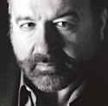
Interlude: Hernando De Soto

Slide 73
Hernando De Soto
    The Mystery of Capital
    Why Capitalism Triumphs in the West
    and Fails Everywhere Else
    (Basic Books, 2000)
    It is the ‘invisible infrastructure of asset management’ upon which the astonishing fecundity of Western capitalism rests

Slide 74
Hernando De Soto
    This invisible infrastructure consists precisely of representations, of property records and titles
    These capture what is economically meaningful about the corresponding assets

Slide 75
Hernando De Soto
    The domain of free-standing Y terms = the domain of what exists in virtue of representations
    “Capital is born by representing in writing—in a title, a security, a contract, and other such records—the most economically and socially useful qualities [of a given asset].
    “The moment you focus your attention on the title of a house, for example, and not on the house itself, you have automatically stepped from the material world into the [non-pnysical] universe where capital lives.”

Slide 76
Hernando De Soto
    What serves as security in credit transactions is not physical dwellings, but rather the equity that is associated therewith.
    This equity is something abstract that is represented in a legal record or title in such a way that it can be used to provide security to lenders in the form of liens, mortgages, easements, or other covenants.
    ^{END OF INTERLUDE}

Slide 77
How Can Searle Save Naturalism?
    Searle’s response to objections pertaining to the existence of free-standing (= non-physical) Y terms:
      the ‘X counts as Y’ formula is not to be taken literally.
    ^{It is a ‘useful mnemonic’.}

Slide 78
^{Searle’s Revised Theory}
    ^{The role of the formula}
    “is to remind us that institutional facts only exist because people are prepared to regard things or treat them as having a certain status and with that status a function that they cannot perform solely in virtue of their physical structure.
    “The creation of institutional facts requires that people be able to count something as something more than its physical structure indicates.”

Slide 79
^{The Revised Theory}
  Searle’s chosen replacement for the counts as formula is:
    people are, in a variety of sometimes highly complex ways, ‘able to count something as something more than its physical structure indicates’
  But this uses the very same formula, and in a way which leaves it open to the very objections marshalled against the original version of the formula itself.

Slide 80
And does not solve the problem:
    For what is it that people are able to count as ‘something ... more than its physical structure indicates’ in the case of a collateralized bond obligation or a statute on tort enforcement?
    Surely (in keeping with Searle’s naturalism) something which has a physical structure.
    But there is no speech act, no document, no piece of paper, no pattern of blips in a computer which counts as an entity of the given type.

Slide 81
^{A further problem:}
    The concept of institutional fact is itself defined by Searle in terms of the counts as formula.
    Hence even if it would be possible to restate the whole thesis of Construction without using the formula,
    since this thesis is itself about ‘how institutional facts are created and sustained’
    we are left in the dark as to what the thesis amounts to.

Slide 82
^{The} Glory Of Searle’s Social Ontology
    the counts as formula provides us with a clear and simple analytic path through the ‘huge invisible ontology’ of social reality.
    There are no special ‘social objects’, but only parts of physical reality which are subjected, in ever more interesting and sophisticated ways, to special treatment in our thinking and acting.

Slide 83
^{THE} MISERY OF SEARLE’S SOCIAL ONTOLOGY
    the ontology of institutional reality amounts precisely ‘to sets of rights, obligations, duties, entitlements, honors, and deontic powers of various sorts’, and thus to free-standing Y terms
    But Searle can provide no account of what such entities might be

Slide 84
The closest he comes is in passages such as:
    “Social objects are always constituted by social acts; and, in a sense, the object is just the continuous possibility of the activity.
    “A twenty dollar bill, for example, is a standing possibility of paying for something.
    “What we think of as social objects, such as governments, money, and universities, are in fact just placeholders for patterns of activities.
    “I hope it is clear that the whole operation of agentive functions and collective intentionality is a matter of ongoing activities and the creation of the possibility of more ongoing activities.”

Slide 85
There are patterns of activities
    associated with, say, governments.
    ^{But governments}
      can enter into treaty obligations,
      ^{can be deposed,}
      ^{can incur debts,}
      ^{can raise taxes,}
      ^{can be despised}
    patterns of activity can do and suffer none of these things

Slide 86
^{Searle’s social ontology}
    is forced to regard all such statements as façons de parler to be cashed out in terms of statements about patterns of activity (on the part of whom, if not ‘members of the government’?)
    ^{Fictionalism vs. Realism}

Slide 87
^{Searle’s hidden strategy}
    is to unfold the huge invisible ontology underlying ordinary social relations by describing those social objects (presidents, dollar bills, cathedrals, drivers’ licenses) which do indeed coincide with physical objects.

Slide 88
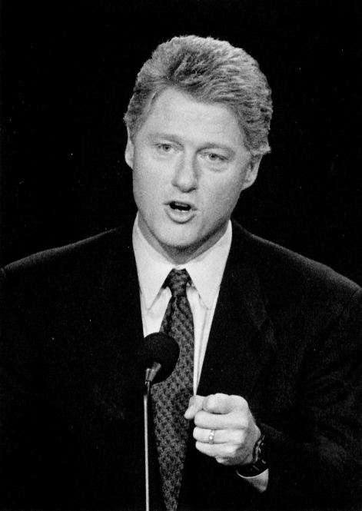

Slide 89
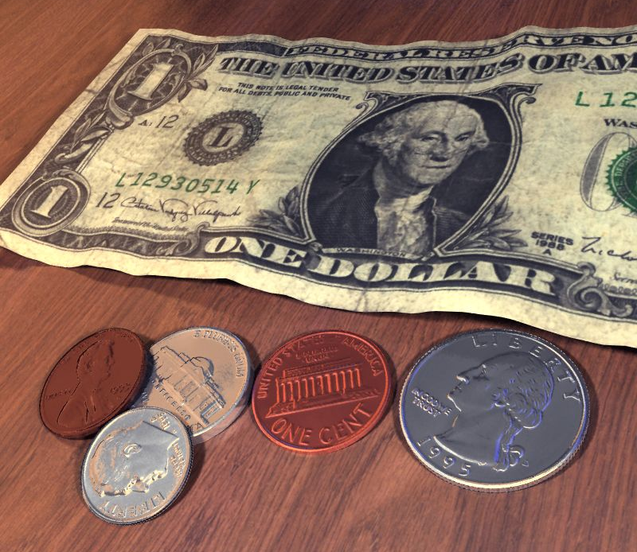

Slide 90
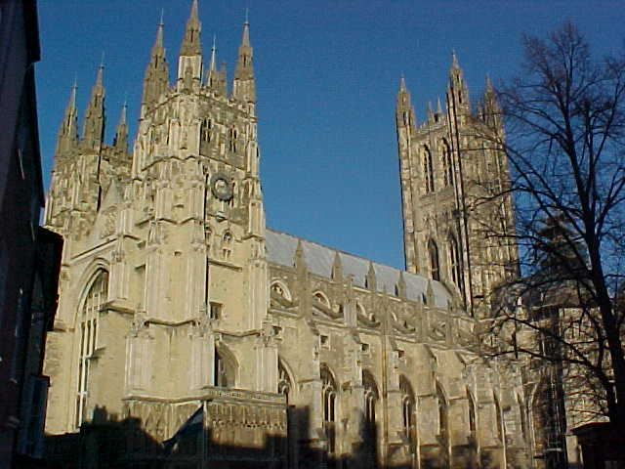

Slide 91
^{Searle’s hidden strategy}
    … ^{surreptitiously, then,} wherever free-standing Y terms are it issue he will talk, not of objects, but rather of (physical and institutional) facts.
    (to grant the existence of free-standing Y terms as objects would be to torpedo Searle’s naturalism)
    (to deny their existence, and to view them as mere fictions, would be to torpedo his realism)

Slide 92
^{Naturalism*}
    = all the facts which belong to institutional reality should supervene on facts which belong to physical reality
    Naturalism* can be saved; the status functions and deontic powers by which our social world is pervaded do after all depend in every case on the attitudes of participants in the given institutions.
    The Searlean ontology can thus be made to work; but its principal ingredient must remain unidentified,

Slide 93
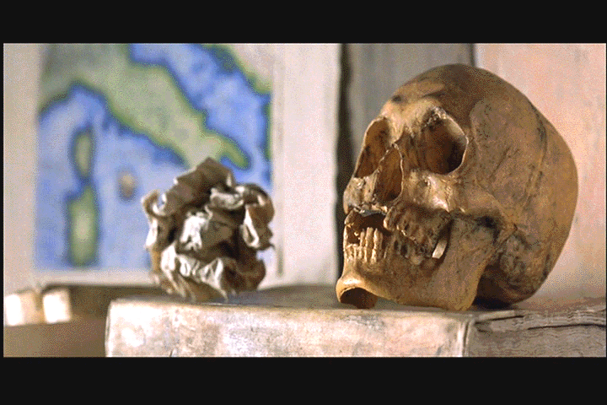
^{It is Hamlet}
without the Prince

